Slide 1
Lecture 36
Memory Management - Policies
Dr. Ehtesham Zahoor
National University of
Computer & Emerging Sciences

Slide 2
Key Design Policies
Fetch Policy
  Demand
  Pre-paging
Replacement Policy
  Optimal
  Least Recently Used (LRU)
  FIFO
  Clock
Operating Systems

Slide 3
Fetch Policy
When a page should be brought into main memory
1. Demand Paging
  A page is brought in memory only when referenced
  Initially a lot of Page faults would happen
  But it will settle down in a while
  Later page faults will drop to a very low level
2. Prepaging
  Pages other than the one demanded are brought in memory
  If pages of a process are stored contiguously in hard disk
  Then Prepaging can reduce a lot of seek time and rotational latency
  But will be ineffective if most of the pages brought in RAM, are not referenced
Operating Systems

Slide 4
Replacement Policy
Selection of a page in memory to be replaced
When a new page must be brought in
Frame locking:
  Some of the frames may be locked
  Thus cannot be replaced
    Key parts of the kernel
    I/O buffers
    Time critical code etc
  We can have a locked bit
Operating Systems

Slide 5
Basic Replacement Algorithms
Optimal
Least Recently used
FIFO
Clock
Operating Systems

Slide 6
Optimal
Select the page for which the time to the next reference is the longest
Just like SJF, very difficult to implement
Assume a memory of 3 frames
And 5 pages
Let the reference sequence be
2 3 2 1 5 2 4 5 3 2 5 2
Operating Systems

Slide 7
Optimal
Page Fault
F
F
F
2 3 2 1 5 2 4 5 3 2 5 2
2
4
3
1
5
Select the page for which the time to the next reference is the longest
Select the page for which the time to the next reference is the longest
Select the page for which the time to the next reference is the longest
Operating Systems

Slide 8
Least Recently Used (LRU)
Replace the page that has not been referenced for the longest time
Again, difficult to implement
E.g.
  Tag each page with the time of last reference
  Should be updated on each instruction/data reference.
Operating Systems

Slide 9
Least Recently Used (LRU)
Page Fault
Page Fault
Page Fault
Page Fault
F
F
F
F
2 3 2 1 5 2 4 5 3 2 5 2
2
3
3
5
1
4
2
Select the page Lest Recently Used
Select the page Lest Recently Used
Select the page Lest Recently Used
Select the page Lest Recently Used
Operating Systems

Slide 10
FIFO
Treats the page frames as a circular buffer
Removed in Round-Robin style
  Simplest to implement
  Replaces the page that has been in the memory longest
The assumption can be wrong
Since, some region of code/data remain alive throughout the programs
Operating Systems

Slide 11
FIFO
F
F
F
F
F
F
Page Fault
Page Fault
Page Fault
Page Fault
Page Fault
Page Fault
2 3 2 1 5 2 4 5 3 2 5 2
2
5
3
3
2
5
1
4
2
Replace the page that has been in the memory longest
Replace the page that has been in the memory longest
Replace the page that has been in the memory longest
Replace the page that has been in the memory longest
Replace the page that has been in the memory longest
Replace the page that has been in the memory longest
Operating Systems

Slide 12
Clock Policy
Additional bit called a use bit
When a page is first loaded in memory, the use bit is set to 1
When the page is referenced, the use bit is set to 1
When it is time to replace a page, the first frame encountered with the use bit set to 0 is replaced.
During the search for replacement, each use bit set to 1 is changed to 0

Slide 13
Clock Policy
When a page has to be replaced
  Pages are considered as a circular buffer
  Scan the buffer
  If the Use bit is 1, set it to zero
  Else If the Use bit is 0, replace this page
  Next search will start from here onwards
  If none of the pages have Use Bit = 1, replace the first page searched
Operating Systems

Slide 14
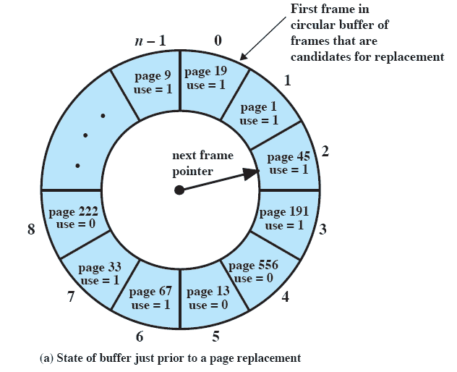
Clock Policy

Slide 15
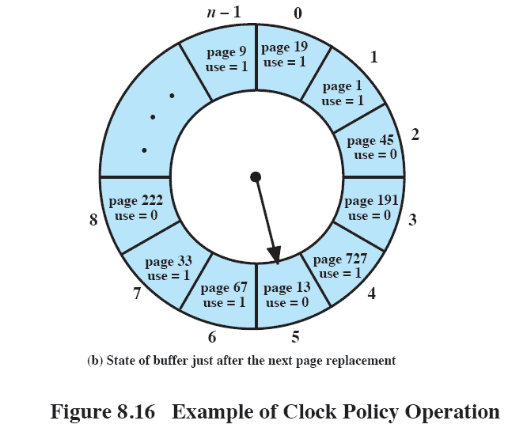
Clock Policy

Slide 16
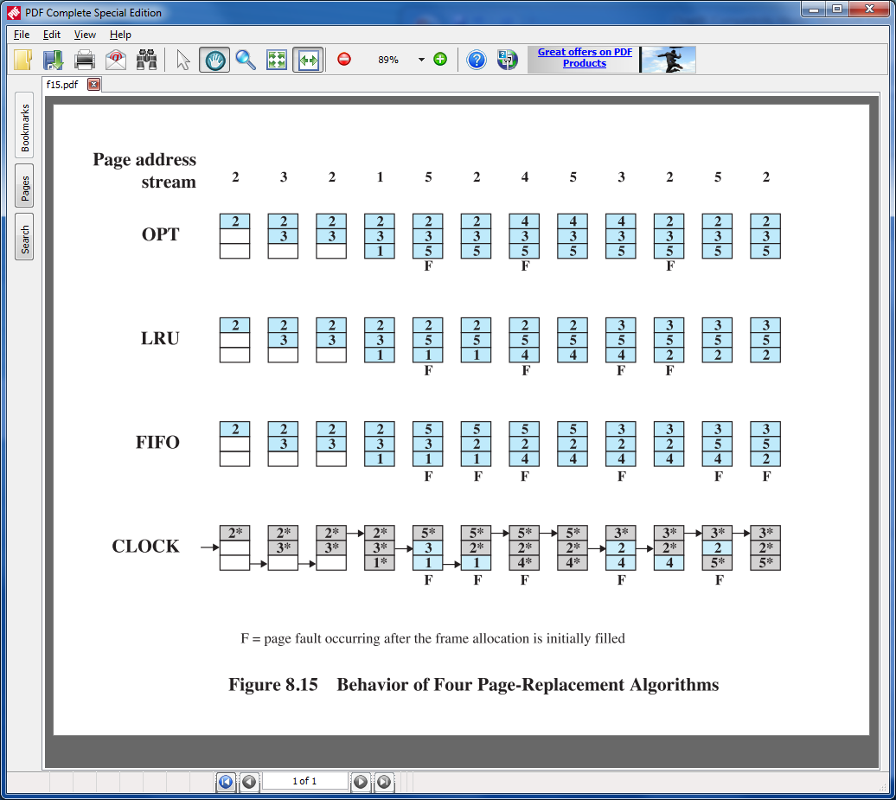
Clock Policy

Slide 17
Clock Policy

Slide 18
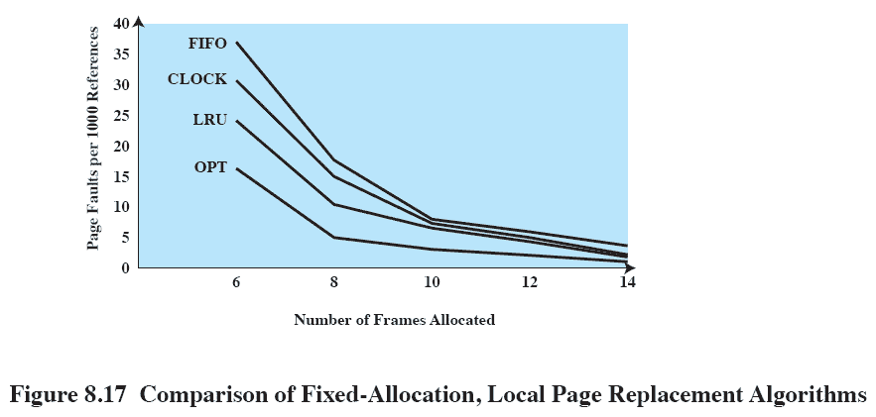
Comparison

Slide 19
Modified Clock Policy
Clock Policy can be made more powerful by using more bits
Makes use of Reference and Modified bits
When a process starts
All its page entries are marked as not referenced and not modified
When a page is referenced
  The R (reference) bit is set
If the page is later written to
  The M (modified) bit is set
Operating Systems

Slide 20
Modified Clock Policy
Periodically the R bit is cleared
Allows to recognize which pages have been recently referenced
When a page fault occurs, the pages are inspected
Divided into four categories based on their R and M bits
  Class 0 : Not Referenced, Not Modified
  Class 1 : Not Referenced, Modified
  Class 2 : Referenced, Not Modified
  Class 3 : Referenced, Modified
Remove the page from lowest numbered non empty class
Operating Systems

